Slide 1
PCIE review
Jiajie Zhang

Slide 2
Agenda
PCIE Specification
Top diagram
Parameter config
Interface signals, pad list
Initialization steps
Effective Throughput
Power-on Reset
ATPG and ATE
Synthesis report
Verification plan
Checklist

Slide 3
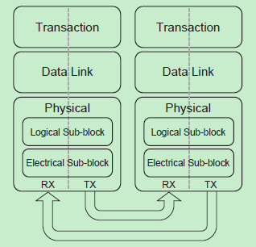
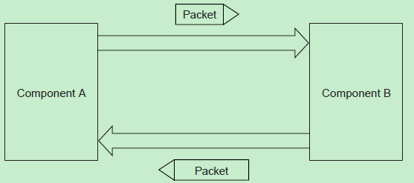
PCIE Specification

Slide 4
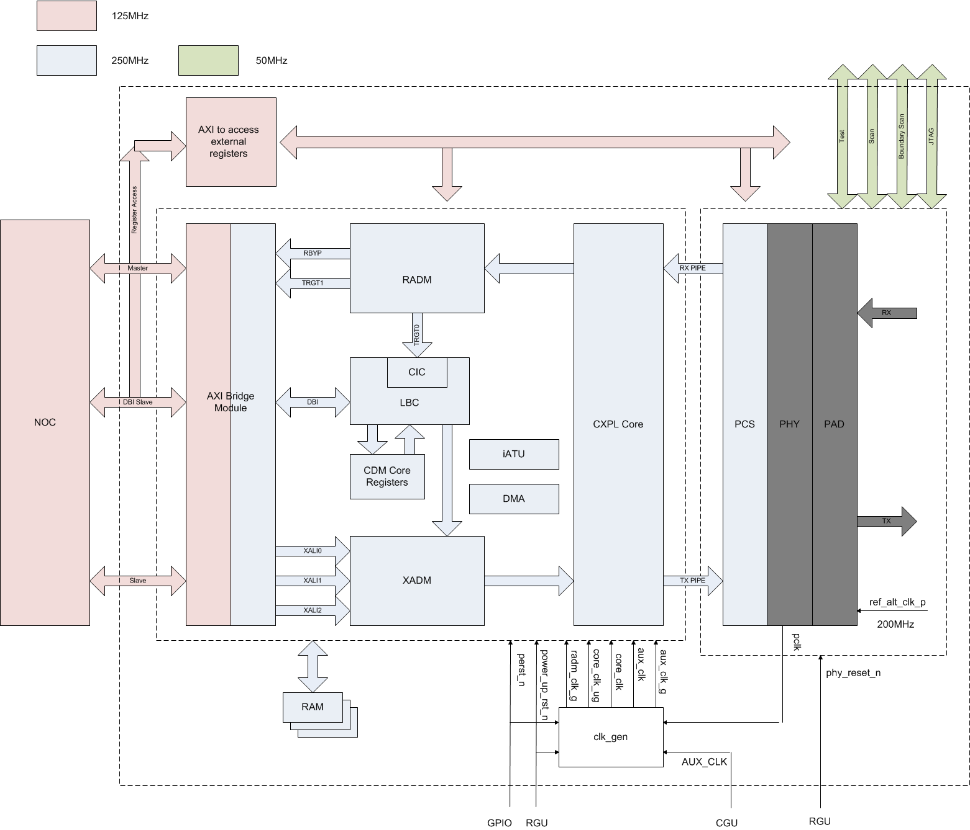
Top diagram

Slide 5
Parameter config
Main Features Config Parameters |  |  | DMA Configuration Parameters
AMBA_INTERFACE | AXI4 (3) | AMBA Enable | CC_NUM_DMA_WR_CHAN | 2 | Number of DMA Write Channels
CC_ACELITE_ENABLE | 0 | ACE Lite Interface | CC_NUM_DMA_RD_CHAN | 2 | Number of DMA Read Channels
CC_DMA_ENABLE | true (1) | DMA Enable | CC_NUM_DMA_RD_TAG | 16 | Number of DMA Read PCIe Tags
CX_NFUNC | 1 | Number of Functions | Basic AXI Config Parameters
Basic Features Config |  |  | MASTER_BUS_ADDR_WIDTH | 32 | Master Address Width
PCIe Basic Features Config Parameters |  |  | MASTER_BUS_DATA_WIDTH | 64 | Master Data Width
CX_FREQ | 125MHz (2) | If the controller is configured for Gen2 Dynamic Frequency, then the frequency will be doubled (x2) when operating at Gen2 speed. | SLAVE_BUS_ADDR_WIDTH | 32 | Slave Address Width
CX_PHY_FREQ | 125MHz (2) | If the PHY is configured for Gen2 Dynamic Frequency, then the frequency will be doubled (x2) when operating at Gen2 speed. | SLAVE_BUS_DATA_WIDTH | 64 | Slave Data Width
CX_GEN2_MODE | Dynamic Frequency (0) | Core Gen2 Mode | CC_SLV_BURST_LEN | 256 | Slave Interface Burst Length. An application master may execute any burst up to a maximum byte size given byCC_SLV_BURST_LEN * (CC_SLV_BUS_DATA_WIDTH / 8) bytes
CX_PHY_GEN2_MODE | Dynamic Frequency (0) | Phy Gen2 Mode | CC_MSTR_BURST_LEN | 256 | Master Interface Burst Length
CX_NL | x2 (2) | Maximum Link Width | CC_DBI_SLV_BUS_ADDR_WIDTH | 32 | DBI Slave Address Width
CX_NW | 32-bit (1) | Datapath Width | CC_DBI_SLV_BUS_DATA_WIDTH | 32 | DBI Slave Data Width
Common Basic Features Config Parameters |  |  | CC_MAX_SLV_TAG | 16 | AHB/AXI Slave Tags
CX_MAX_MTU | 256 | PCIe Max Payload Supported | CC_MAX_MSTR_TAGS_AXI | 32 | AXI Master IDs
CX_MAX_TAG | 32 | Max Outbound NP Requests
CX_INTERNAL_ATU_ENABLE | true (0x1) | Enables the instantiation of the internal address translation unit (iATU)
CX_ATU_NUM_OUTBOUND_REGIONS | 2 | Number of Outbound Address Translation Regions
CX_ATU_NUM_INBOUND_REGIONS | 2 | Number of Inbound Address Translation Regions

Slide 6
Interface signals, pad list
DWC_pcie_dm |  | DWC_pcie_dm |  | PCIe 2 PHY
AXI Clock and Reset Signals | CGU/ RGU | SII: General Core Control Signals | REG | PIPE Interface | INTERNAL
AXI Master Interface Signals | NOC AXI/ REG | SII: General Messaging Reception Signals | REG | Termination Tuning | DEBUG IO/ REG
AXI Slave Interface Signals | NOC AXI/ REG | SII: Interrupt Signals | INT | Clocks and Resets | CGU/ RGU/ DEBUG IO
Clock and Reset (APM) Signals | GPIO/ REG | SII: Link Reset/Status Signals | INT/ REG | Parameter Controls | REG
ELBI Interface Signals | ELBI | SII: PM, Unlock, and Error Messages Signals | REG | Power Supply Signals | PAD
MSI Interface Signals | ELBI | SII: Power Management Signals | REG | Test Controls | REG
VMI Signals | ELBI | SII: Receive Control/CPL Timeout Signals | REG | Signals Connected to Pads | PAD
SII: Configuration Information Signals | REG | SII: Transmit Control Signals | REG | Control Register Access | REG
SII: Debug Signals | DEBUG IO | Common PIPE Signals | INTERNAL | Boundary Scan | IO
SII: Electromechanical Signals | REG | Gen2/3-Only PIPE Signals | REG | JTAG Port | IO
 |  | RAM Signals | INTERNAL | Scan Interface | IO

Slide 7
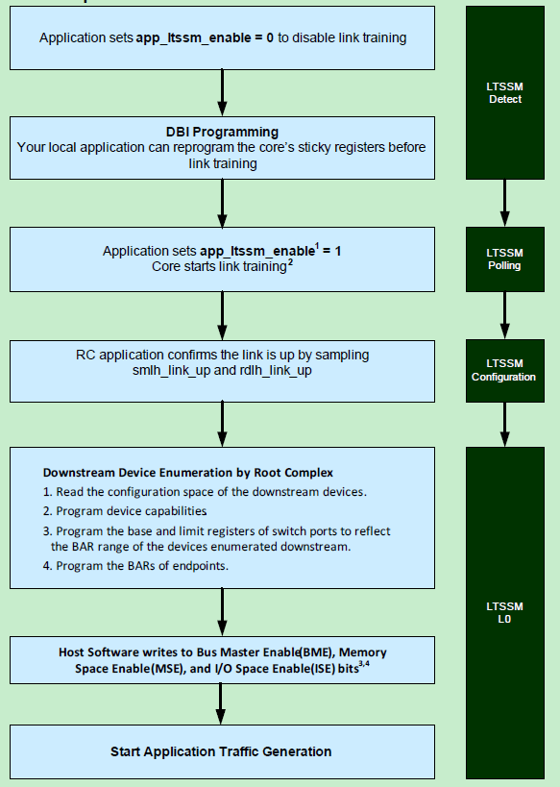
Initialization steps
Immediately upon powerup the DM controller goes into either EP mode or RC mode, depending on the state of the device_type input.
A change in device_type must be associated with a full reset.

Slide 8
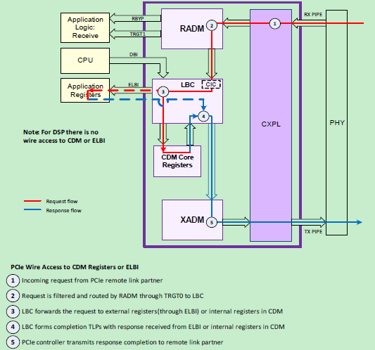
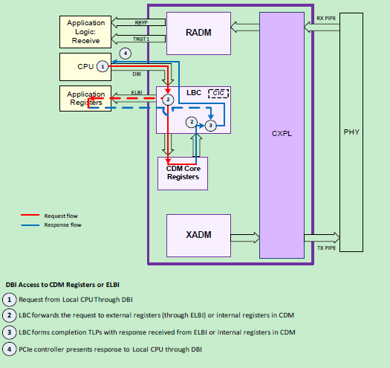
Local Bus Controller

Slide 9
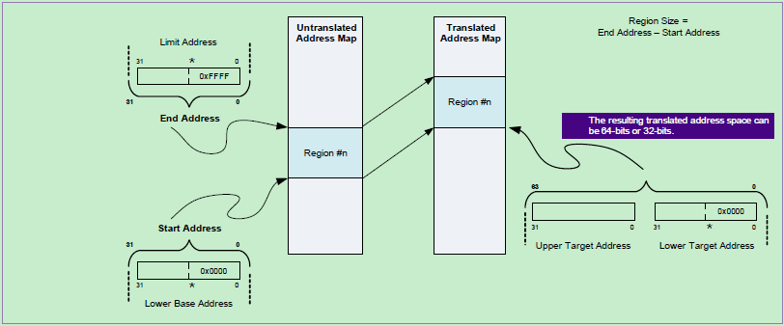
Internal Address Translation
Address Match mode operation for MEM and I/O, CFG, and MSG TLPs. No translation for completions.
Supports type translation through TLP type header field replacement for MEM or I/O types to MSG/CFG types.
DMA bypass mode to allow TLPs which are initiated by the embedded DMA engine, to pass through the iATU untranslated.

Slide 10
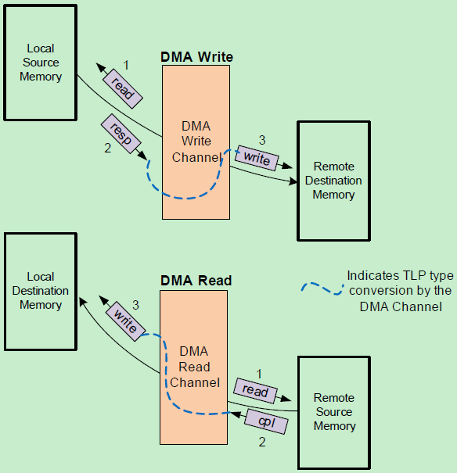
Embedded DMA
program DMA control registers directly with the local CPU through the DBI or remotely over the PCIe link.

Slide 11
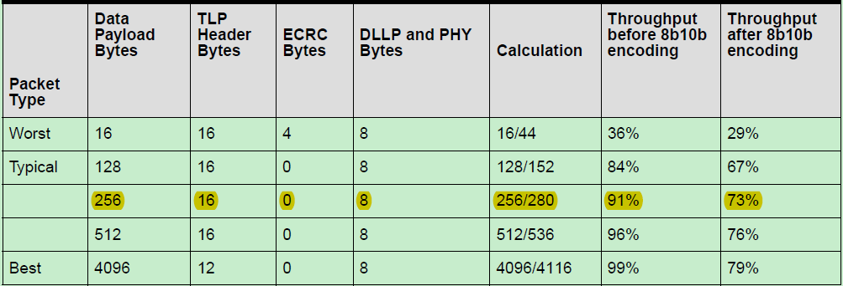
Effective Throughput
5Gb/s per lane

Slide 12
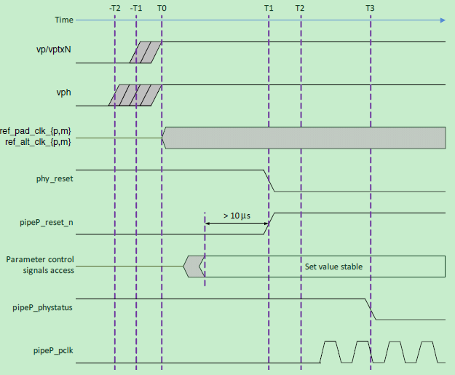
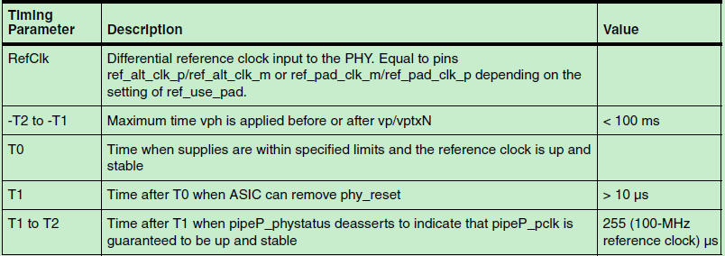
PHY power-on reset
vp: PHY analog and digital supply, 0.9V
vph: High-voltage power supply, 3.3/1.8 V
vptxN: PHY transmit supply, similar to vp

Slide 13
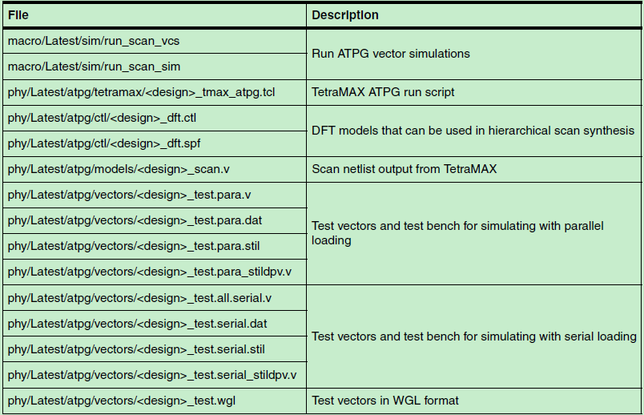
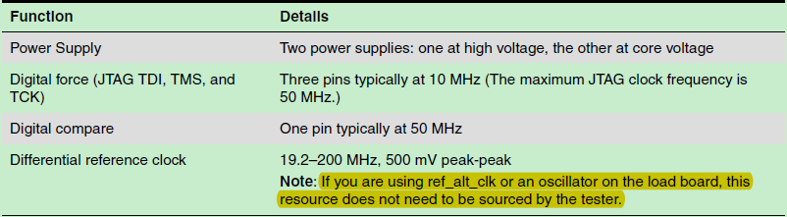
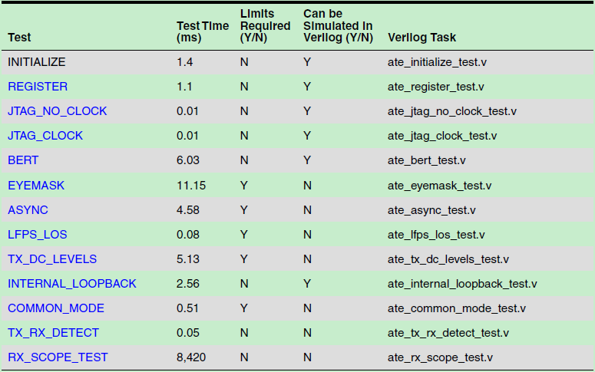
ATPG and ATE

Slide 14
Status
Synthesis
Formality
- controller/ phy passed with our env, top still debugging
Verification
- ip env, testlist passed
- soc env, one test ready and passed (with pcie vip integrated)
- veloce env, not ready
sub system name | total area | memory | phy | inst number | tech lib
PCIE_TOP | 1.1000 | 0.1200 | 0.7600 | 251,198 | 7T | 2ch

Slide 15
Checklist
 | Sub-CLASS | Items | Description | Status | Comment
IP/Subsytem Checklist | Document | IP Release Note | Describes the content of IP package,and the updates to last version. | done | core - 4.90a, phy - June 3 2016
 |  | IP datasheet | Must include full register map and description, I/O structures, block description and sub IP partitioning. | done | DWC_pcie_dm_databook, DWC_pcie_dm_registers dwc_pcie2_phy_tsmc28hpc_09V18V_databook
 |  | IP DFT/ATE test spec (mostly for AMS IPs) | Must define what it contains (must include description of test protocol for special test modes) | done
 |  | IP integration Manual | Requiremnt for IO/Clock/Rest/DFT; IP block digarm; Port descriptions and connections in SOC | done
 |  | IP verfication spec and report | Bench and test cases descriptions; code coverage; functional coverage | pending | no code coverage and functional coverage by synopsys, case 8000976465
 |  | IP programing guide | Description of IP bring up, Register settings for different modes | pending | Simple guide in databook, case 8000976477
 |  | IP data flow /floorplan/TOP diagram | Description of connections among sub-blocks, memories, backend floorplan | done
 |  | IP package/PCB guide | Description of Ball assignment/PCB layout | pending | no PCB layout, double check in case 8000975965
 | Design | IP configure | Include IP feature configure | done
 |  | RTL | RTL code, netlist, behavior models | pending | top formality debugging
 |  | Design File List | File list for Chip test bench build. | done
 |  | Memory list | Memory configure list | done
 |  | IP fake model | dummy IP subsystem top | done
 |  | IP unit verification environment | Bench,test cases, scripts ,logs, coverage reports, failed case,issue | done
 |  | IP synthesis environment | Scripts,SDC,netlist,logs, report | pending | formality failure
 |  | IP Formal check environment | Scripts, report | pending | failure debugging
 |  | IP ATPG environment | Scripts, report | pending | only phy
 |  | IP verification Plan | Include SOC level/Veloce/FPGA verification test report. | pending | only have one soc level test passed
 |  | IP NLS Maturity Check | release netlist, chiplevel backend SDC | pending
 | Software | IP SW driver | Software driver for application | pending | only linux driver, case 8000936062

Slide 16
Thanks
Q&A

